Slide 1
Charity management system
Name:- Shweta Bhosale
Project:- MYSQL

Slide 2
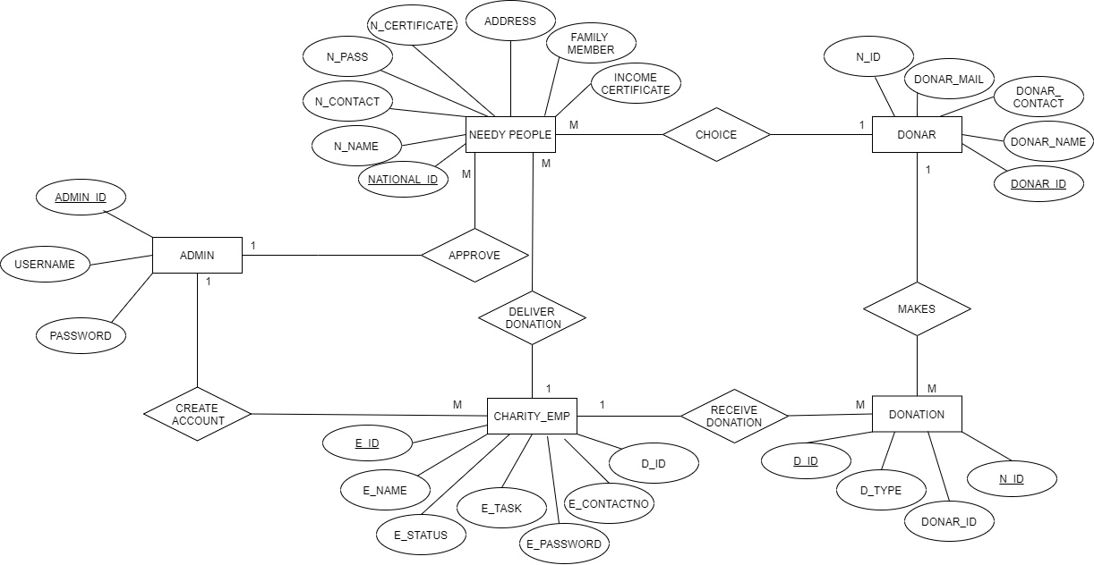
ER DIAGRAM

Slide 3
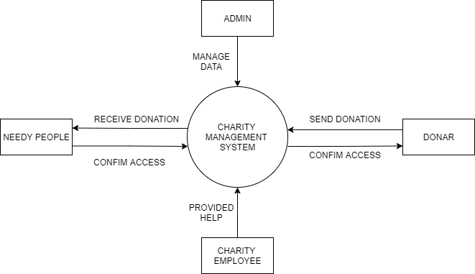
DFD DIAGRAM

Slide 4
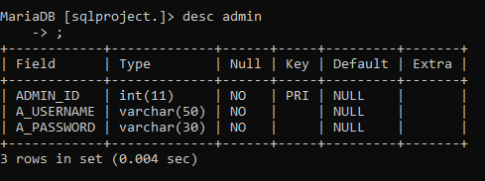
DESC ADMIN

Slide 5
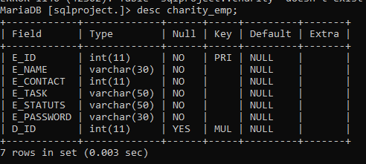
DESC CHARITY_EMP

Slide 6
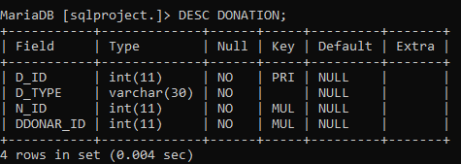
DESC DONATION

Slide 7
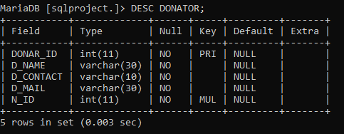
DESC DONATOR

Slide 8
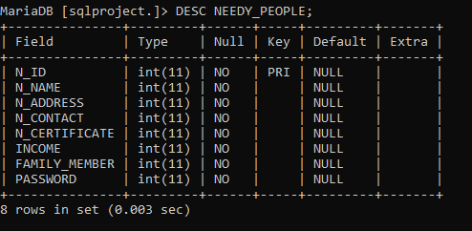
DESC NEEDY_PEOPLE

Slide 9
THANK YOU

